Slide 1
#2 Making fRiends with: ggplot2
library(dplyr)
rladies_global %>%
filter(city == ’Munich')

Slide 2

Hello!
I am Pam
And today I am very excited to share with you some tips on how to get beautiful plots using ggplot2

Slide 3
Smoothly
sliding into ggplot2
🎨
1. First steps
2. Base Graphics vs ggplot2
3. ggplot2 & Grammar of Graphics
4.
(or hands-on stuff)
Pro tip: Do stop and ask me at any time!

Slide 4
1.
First steps
Take a visit to the GitHub repo https://github.com/pamelamatias/RLadies_MUC
and either clone or download the files we’ll be using ☺

Slide 5
2.
Base Graphics vs ggplot2
sg

Slide 6
Base graphics
hist(housing$Home.Value)
ggplot2
more verbose for simple plots
less verbose for complex graphs
data always as data.frame

Slide 7
3.
Grammar of Graphics & ggplot2
sg

Slide 8
Grammar of Graphics
ggplot2
Independent building blocks
data
aesthetic mapping
geometric object
statistical transformations
scales
coordinate system
position adjustments
faceting

Slide 9
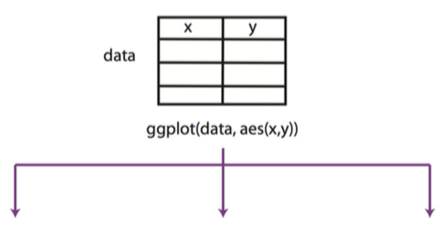
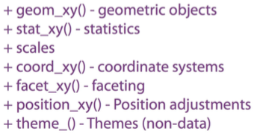
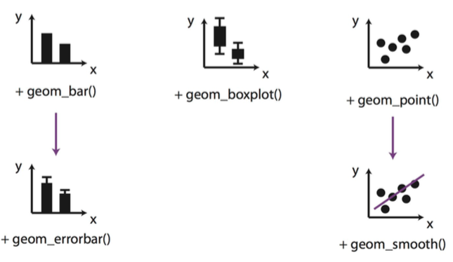
Basic idea behind
ggplot2
rladies_global %>%
diagram.source(city == ’Berlin')

Slide 10
As Obi-Wan Kenobi may have said in Star Wars: “Use the source, Luke!"
—Barry Rowlingson
(answering a question on the documentation of some implementation details) R-devel (January 2010)

Slide 11
4.
🎨
(or hands-on stuff!)

Slide 12
Dataset
Inside Airbnb: Berlin

Slide 13
BIG CONCEPT

Slide 14
In two or three columns
Column 1
First column.
Column 2
Second column.
Column 3
Third column.

Slide 15
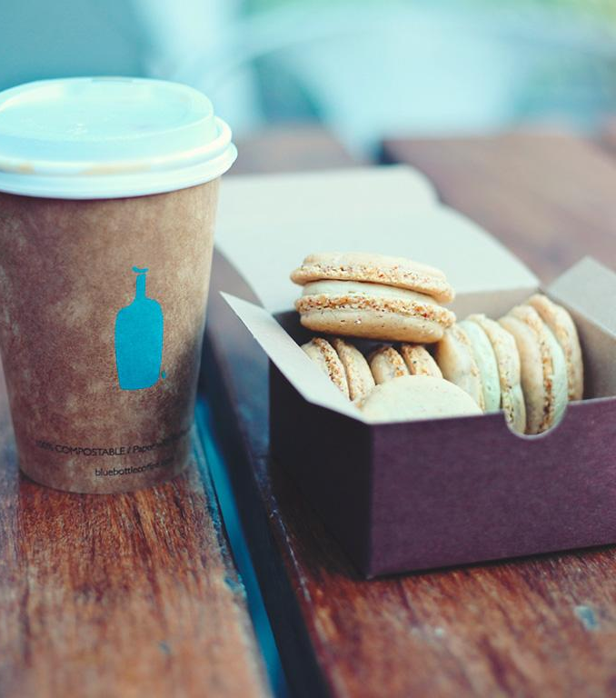
A picture is worth a thousand words
Nice image!

Slide 16
This is how your charts could look
Purple
White
Purple

Slide 17
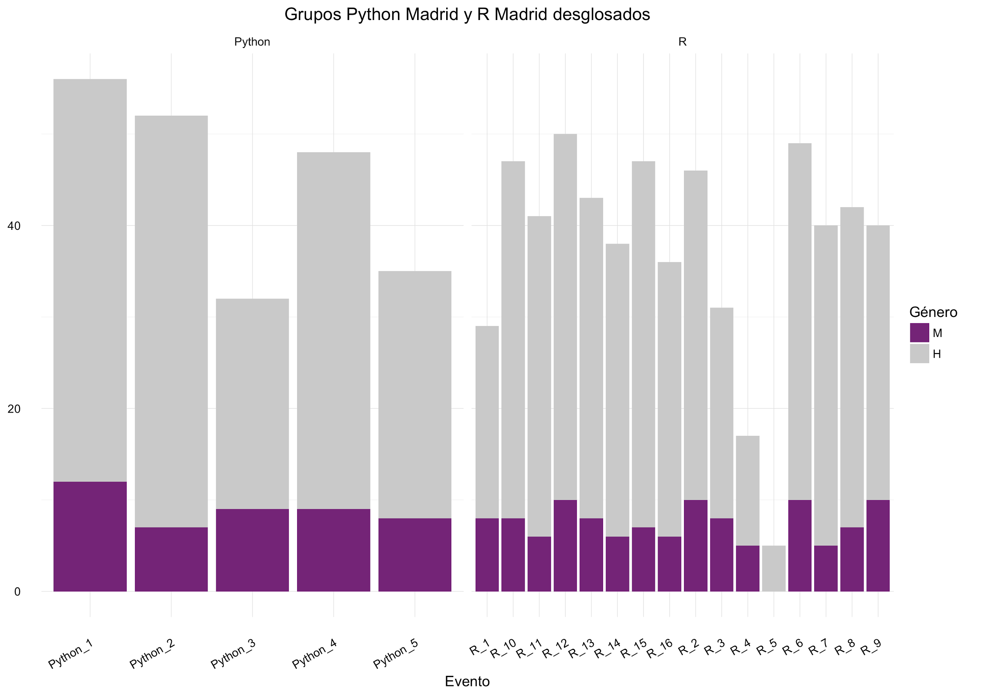
Or with ggplot2
Well, this one is a bit ugly but you get the idea.

Slide 18
89,526,124$
185,244 users
100%
That’s a lot of money
And a lot of users
Total success!

Slide 19
SlidesCarnival icons are editable shapes.
This means that you can:
Resize them without losing quality.
Change line color, width and style.
Isn’t that nice? :)

Slide 20
😉
Now you can use any emoji as an icon!
And of course it resizes without losing quality and you can change the color.
How? Follow Google instructions https://twitter.com/googledocs/status/730087240156643328
✋👆👉👍👤👦👧👨👩👪💃🏃💑❤😂😉😋😒😭👶😸🐟🍒🍔💣📌📖🔨🎃🎈🎨🏈🏰🌏🔌🔑

